Slide 1

Talking from the seed
朱建奎
2018.08.30

Slide 2

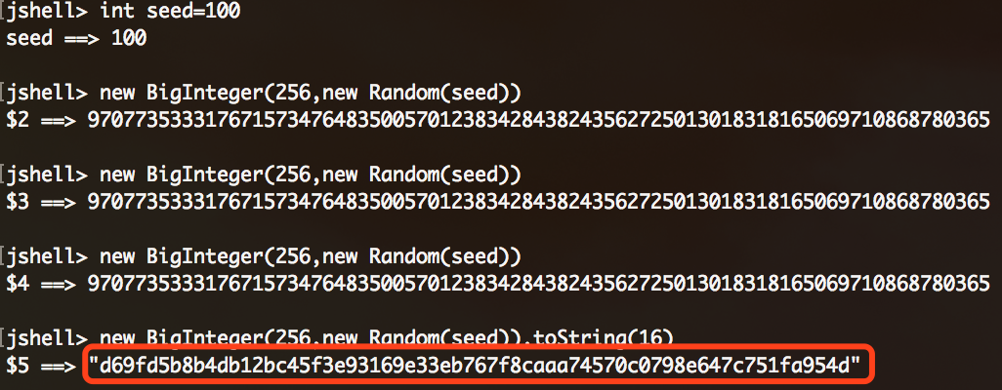
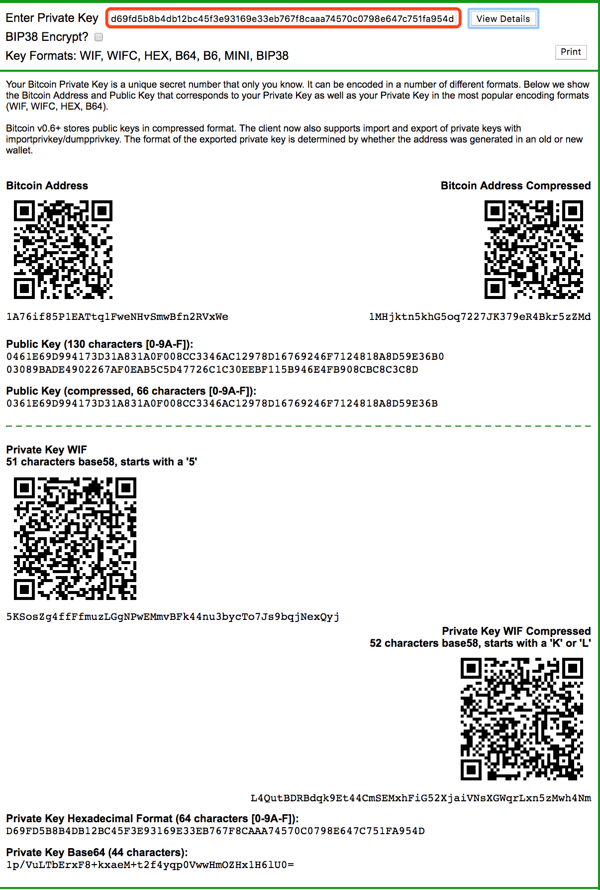
generate a private key:(32 bytes)
import the private key:(bitaddress)
If anyone know your algorithm and your seed,
He or she owns all your assets.
If your seed is not random,
you will lose all your assets.

Slide 3
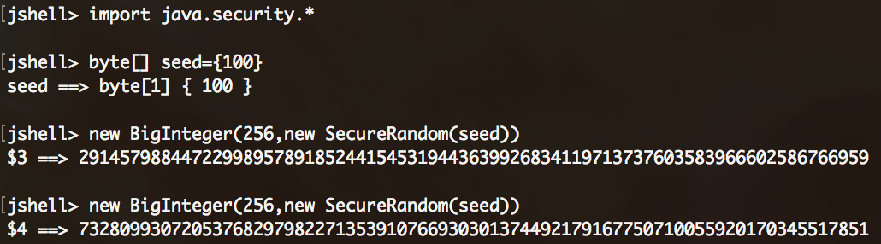
Another secure one?(same seed, different key?)
Secure Random-->/dev/urandom
Some SecureRandom Thoughts
The Right Way to Use SecureRandom
SecureRandom should try /dev/urandom first
https://mp.weixin.qq.com/s/UjgqNS19K3dKRn1qZoTiag
https://mp.weixin.qq.com/s/eqXnsfuYXVFvcKtkSK-ahA
https://mp.weixin.qq.com/s/wb19sM847dyQIrknglPIig

Slide 4
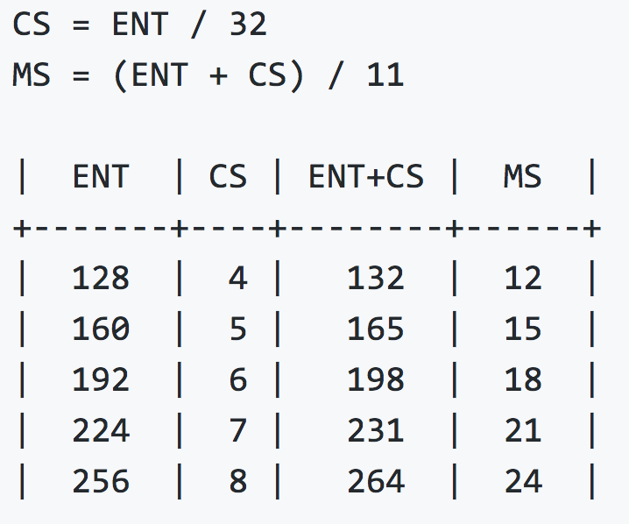
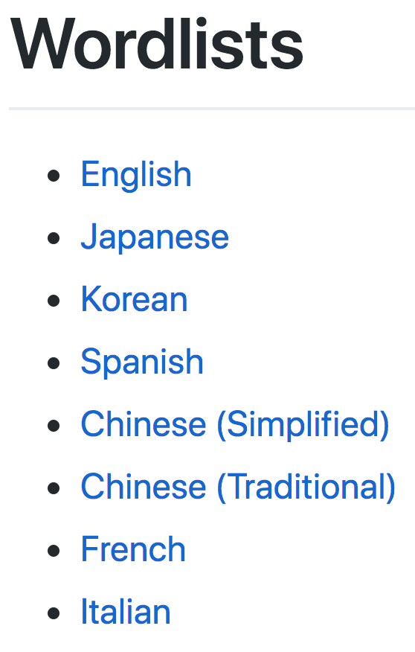
bip0039:Mnemonic code for generating deterministic keys
Mnemonic
Seed
The following table describes the relation between the initial entropy length (ENT),
the checksum length (CS) and the length of the generated mnemonic sentence (MS) in words.
A user may decide to protect their mnemonic with a passphrase.If a passphrase is not present, an empty string "" is used instead.
To create a binary seed from the mnemonic, we use the PBKDF2 function with a mnemonic sentence (in UTF-8 NFKD) used as the password and the string "mnemonic" + passphrase (again in UTF-8 NFKD) used as the salt. The iteration count is set to 2048 and HMAC-SHA512 is used as the pseudo-random function. The length of the derived key is 512 bits (= 64 bytes).
This seed can be later used to generate deterministic wallets using BIP-0032 or similar methods.

Slide 5
bip-0032:Hierarchical Deterministic Wallets
Master key generation
The total number of possible extended keypairs is almost 2512, but the produced keys are only 256 bits long, and offer about half of that in terms of security. Therefore, master keys are not generated directly, but instead from a potentially short seed value.
Generate a seed byte sequence S of a chosen length (between 128 and 512 bits; 256 bits is advised) from a (P)RNG.
Calculate I = HMAC-SHA512(Key = "Bitcoin seed", Data = S)
Split I into two 32-byte sequences, IL and IR.
Use parse256(IL) as master secret key, and IR as master chain code.
In case IL is 0 or ≥n, the master key is invalid.
Hierarchical Deterministic Key Creation

Slide 6
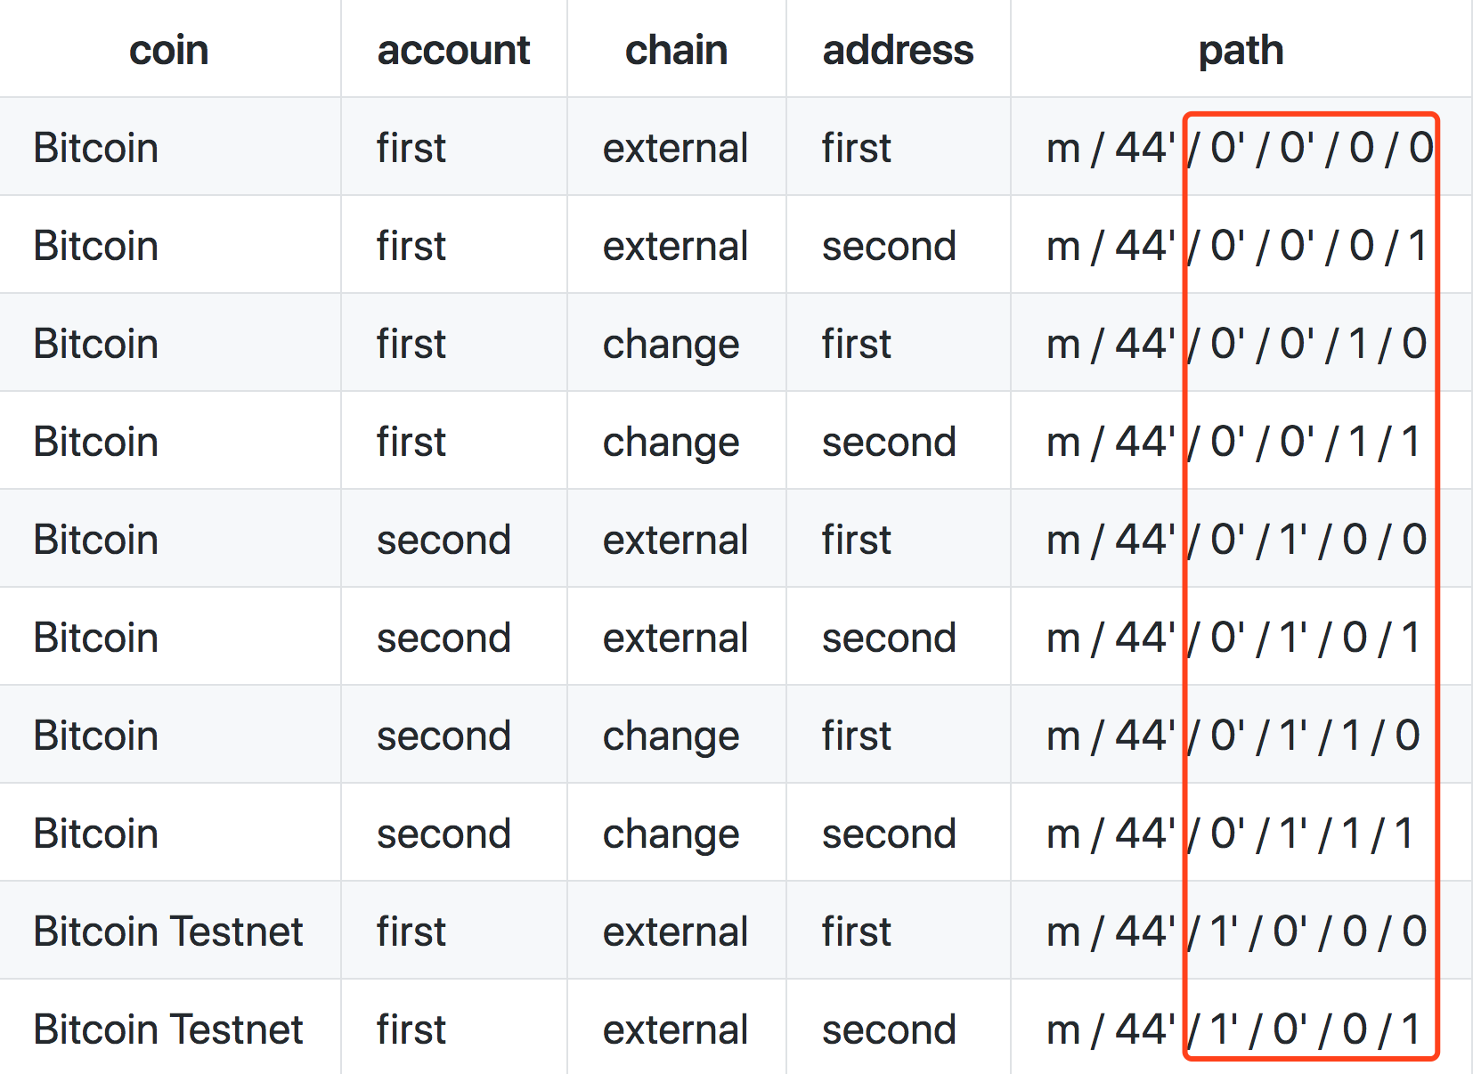
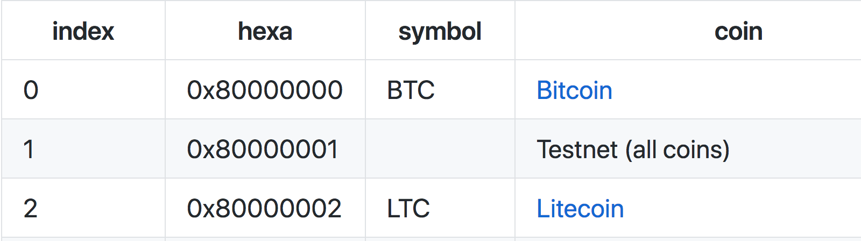
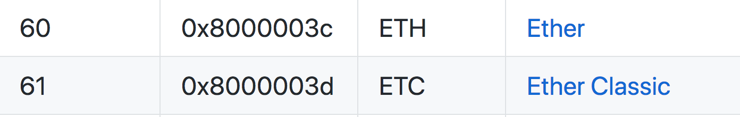
bip-0044:Multi-Account Hierarchy for Deterministic Wallets
Path levels:
SLIP-0044 : Registered coin types for BIP-0044
m / purpose' / coin_type' / account' / change / address_index

Slide 7
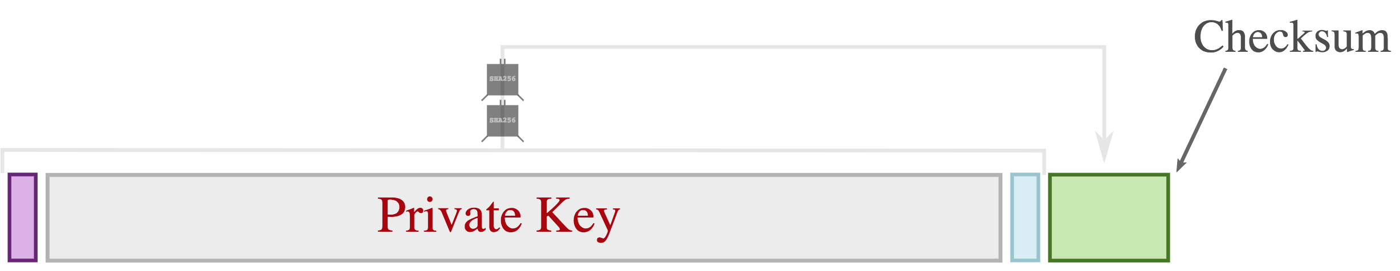
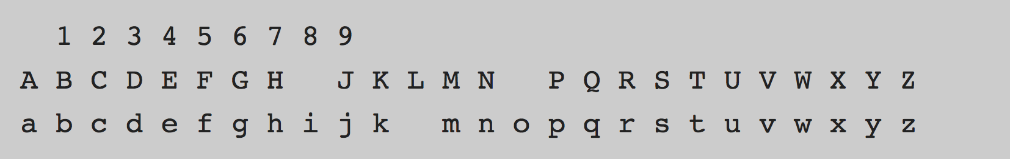
Bitcoin address
WIF
Base58
ECDSA
secp256k1
Elliptic Curve Cryptography: a gentle introduction

Slide 8
ECDSA:secp256k1
y² = x³+ax+b
y² = x³ + 7
P+Q=R
The base point G in compressed form is:
G = 02 79BE667E F9DCBBAC 55A06295 CE870B07 029BFCDB 2DCE28D9 59F2815B 16F81798
and in uncompressed form is:
G = 04 79BE667E F9DCBBAC 55A06295 CE870B07 029BFCDB 2DCE28D9 59F2815B 16F81798 483ADA77 26A3C465 5DA4FBFC 0E1108A8 FD17B448 A6855419 9C47D08F FB10D4B8
Finally the order n of G and the cofactor are:
n = FFFFFFFF FFFFFFFF FFFFFFFF FFFFFFFE BAAEDCE6 AF48A03B BFD25E8C D0364141
h = 01
let p=private key (Big Int)==>some steps==> ECPoint P
==>P(public key:Big Int 512bits=64 bytes)
coordinate x:32 bytes
coordinate y:32 bytes
P=pG
Private key-->Public key, then how to generate the address?

Slide 9
Mnemonic words:
甜 强 降 蓝 谐 森 敬 足 溶 突 凝 方 护 凝 贷
Password:
password
BTC Path:
M/44H/0H/0H/0/0
ETH Path:
M/44H/60H/0H/0/0
ACT Path:
M/44H/666H/0H/0/0
...............
Mnemonic Code Converter

Slide 10
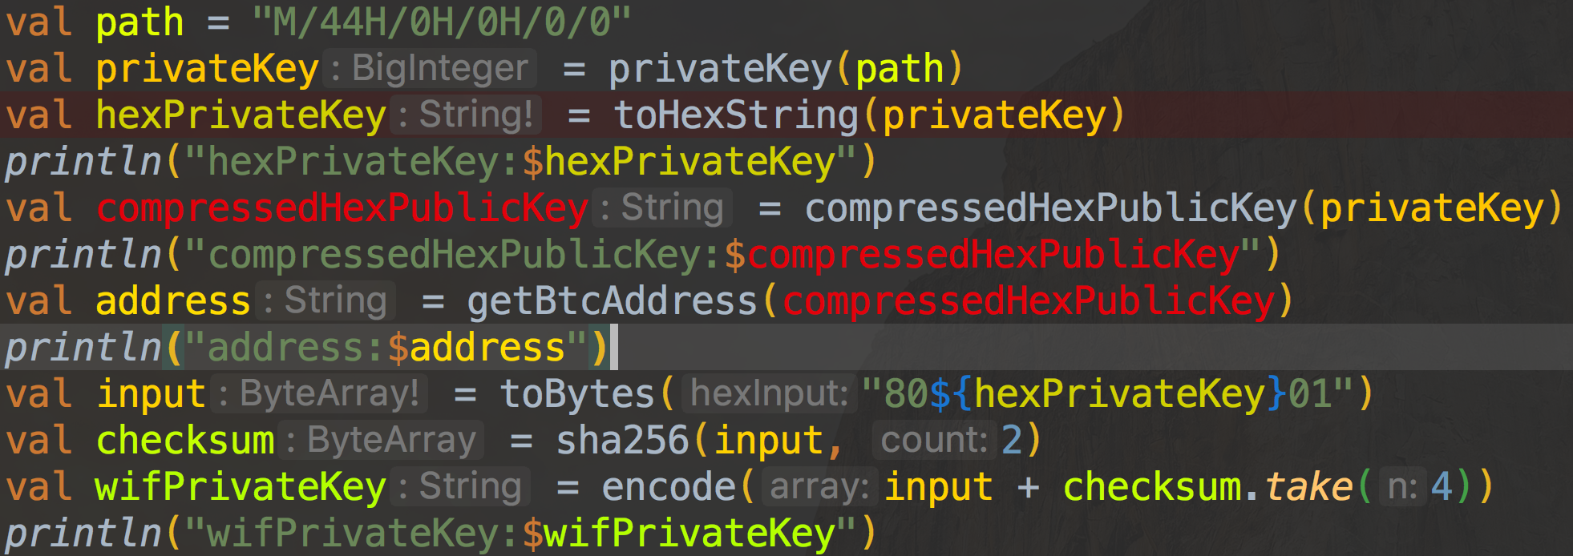
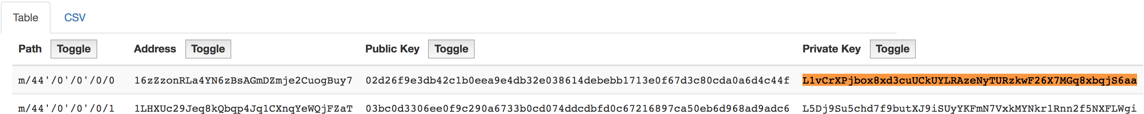
BTC

Slide 11
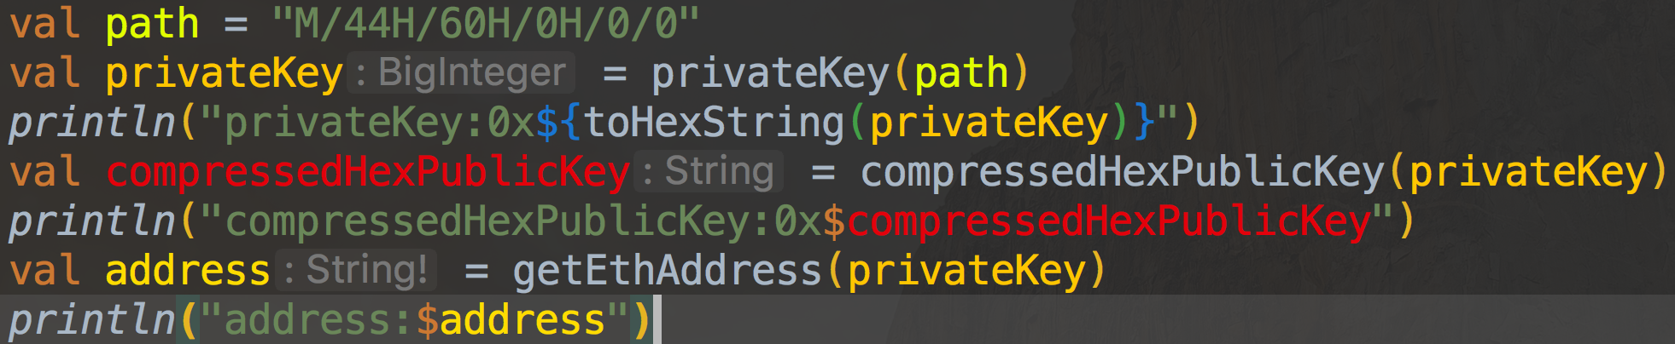
ETH
Keccak.Digest256:right most 20 bytes)

Slide 12
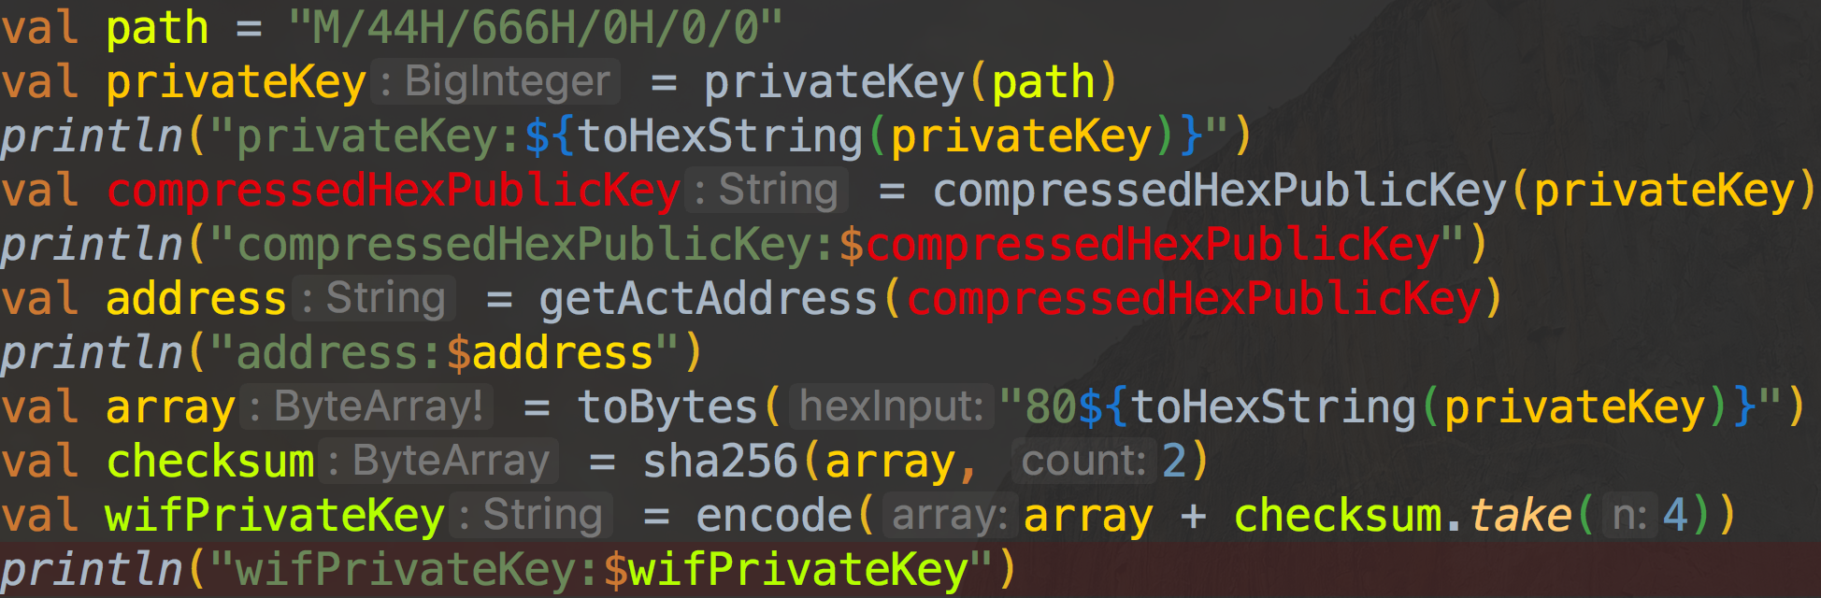
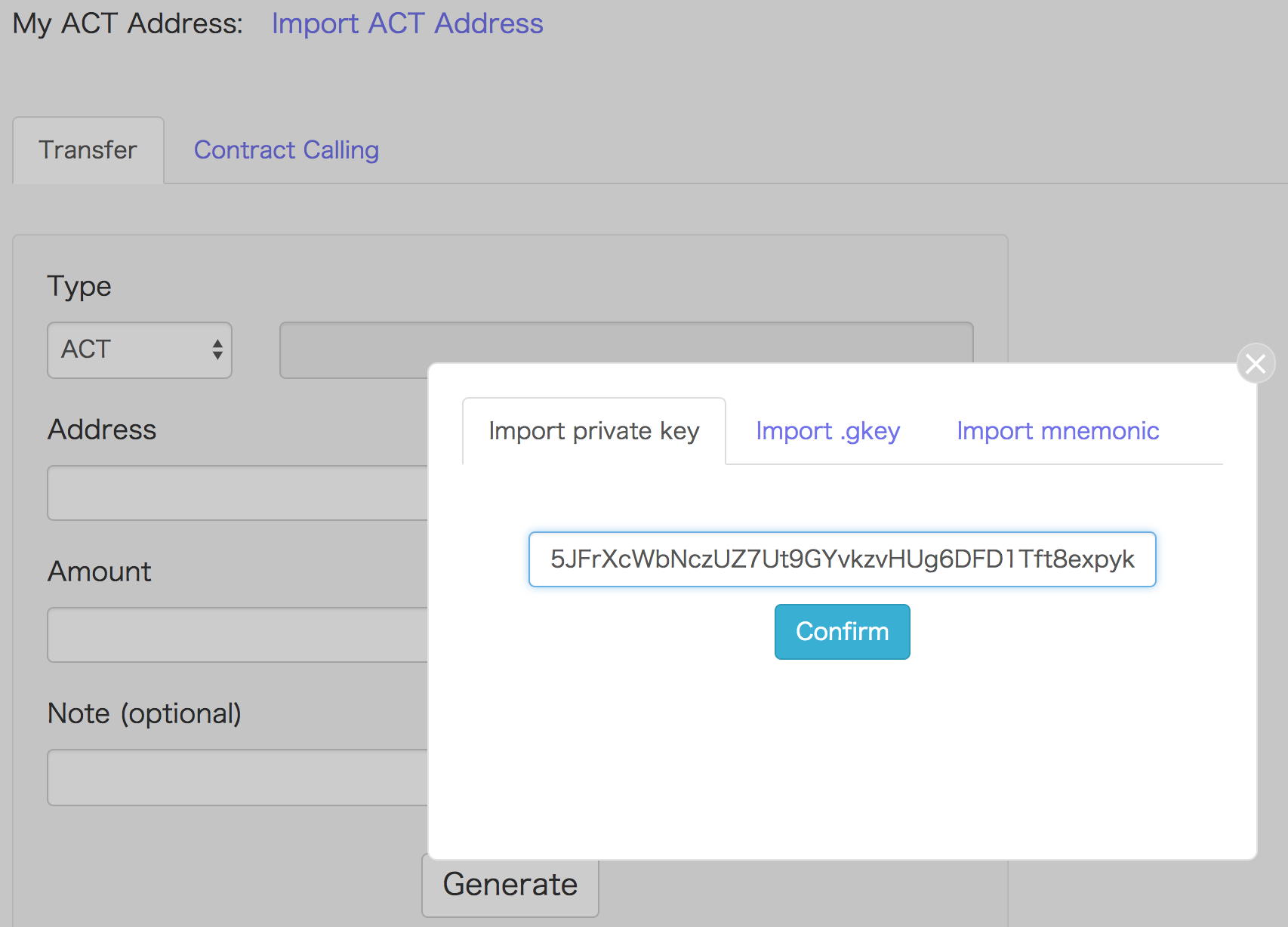
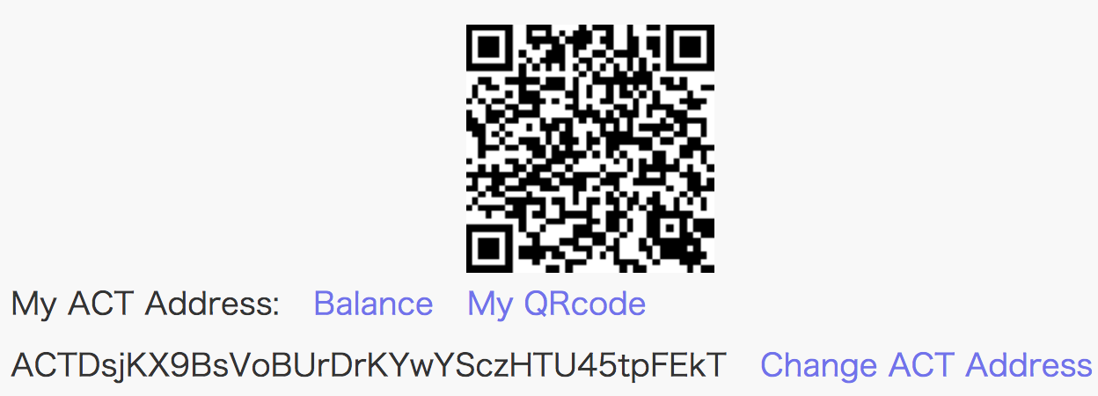
ACT

Slide 13
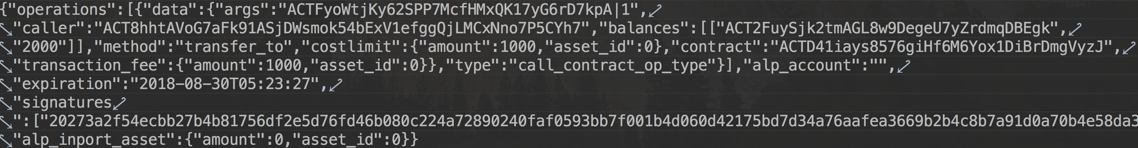
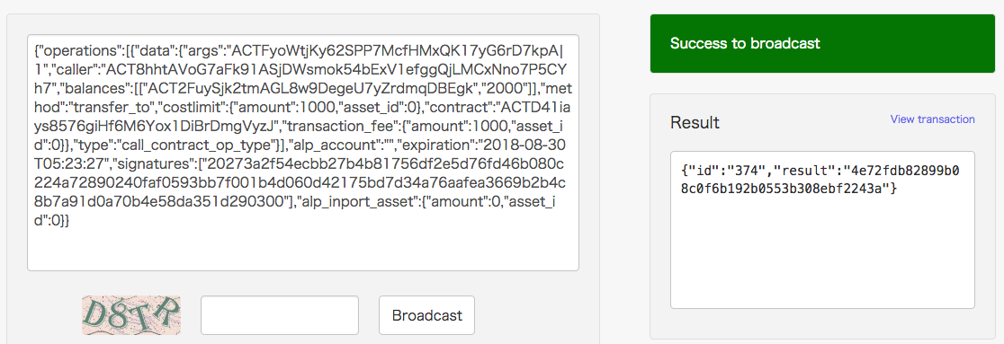
Transfer KCASH(ATP)
txId: 4e72fdb82899b08c0f6b192b0553b308ebf2243a

Slide 14
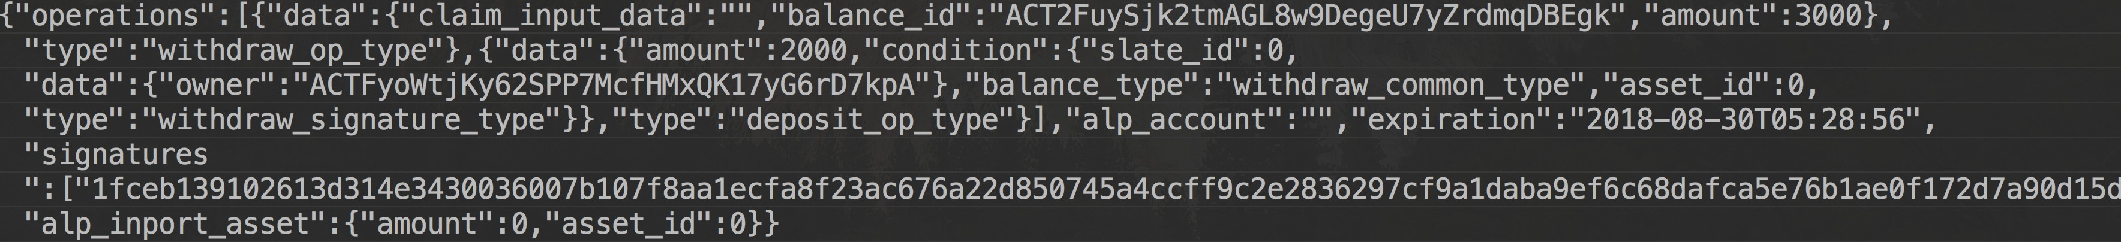
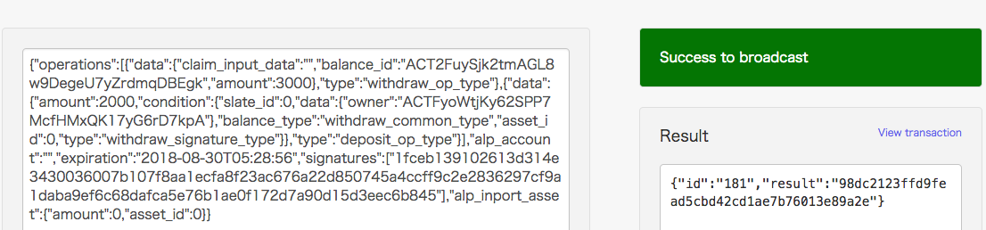
Transfer ACT
txId: 98dc2123ffd9fead5cbd42cd1ae7b76013e89a2e

Slide 15
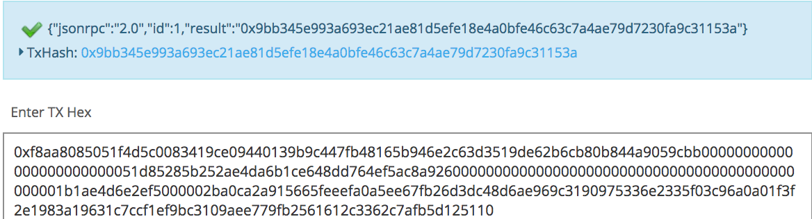
Transfer FLYME(ERC20)
txId: 0x9bb345e993a693ec21ae81d5efe18e4a0bfe46c63c7a4ae79d7230fa9c31153a

Slide 16
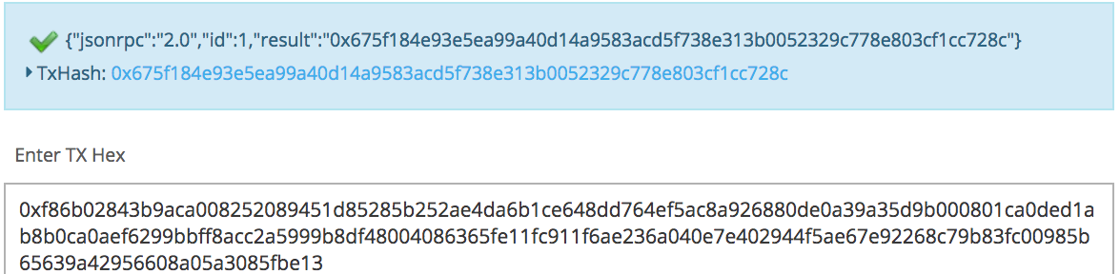
Transfer ETH
txId: 0x675f184e93e5ea99a40d14a9583acd5f738e313b0052329c778e803cf1cc728c

Slide 17
Thanks!

